Slide 1
“Snubbed or Not Snubbed” : Statistical Analysis of NBA’s 75th Anniversary List
Final Project
Group Members: Neil Pareddy, Shivam Zala, Yu Kang, Zaire Wade and Zhonghao Xue
ANLY-511-01

Slide 2


Slide 3




Slide 4
Dataset

Slide 5
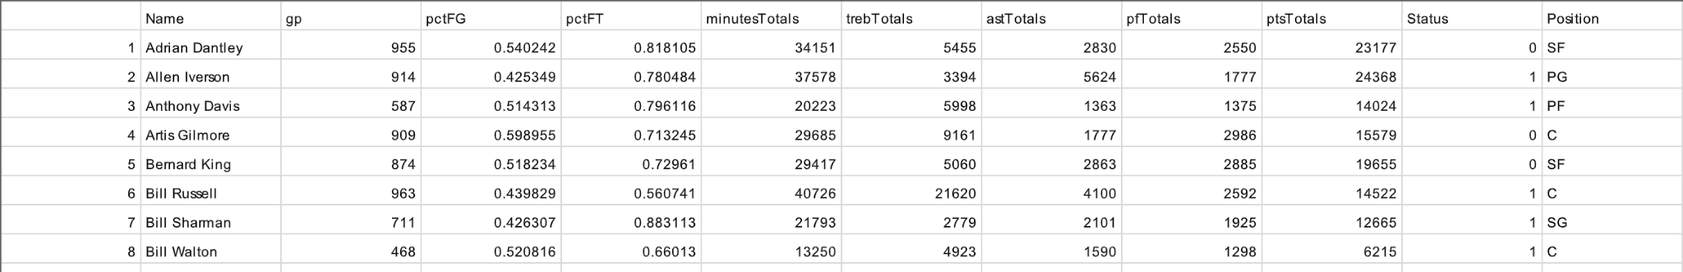
NBA’s 75th Anniversary List
9 variables for each player, including the categorical variable “Position”
Our target is the variable Status (0 = Snubbed, 1 = Listed)
Outlier Patrick Ewing duplicate removed
4 variables removed as they were strongly correlated with PCTFG/PCTFT describing accuracy rate of shots

Slide 6
Statistical Methods

Slide 7
Multiple Linear Regression
Estimate the relationship between the variable status and the variable position
We do the linear regression model for each position accordingly (SG, C, PF, PG, and SF)
For our null hypothesis, we assume there is no difference between the positions that we are selecting and the status that whether the player from that position is listed or not.
Based on the test statistic, we fail to reject the null hypothesis. Thus, there is no relationship between the position that the player is playing and whether they are listed or not.
Notes:
Thus, we want to test whether player from certain positions is more likely to be selected in to the top 75 player list or not?

Slide 8
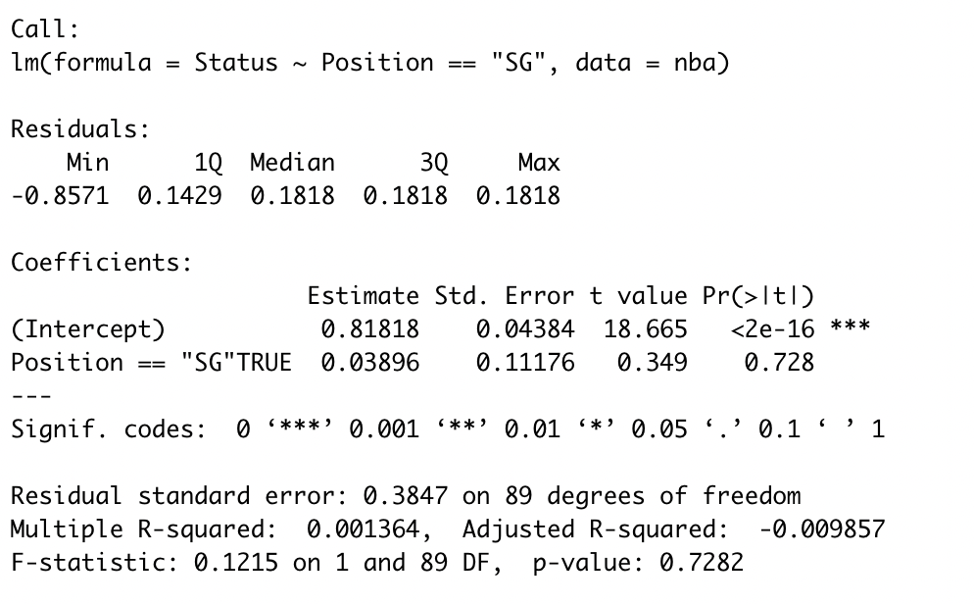
Test Statistics for SG (Shooting Guard)

Slide 9
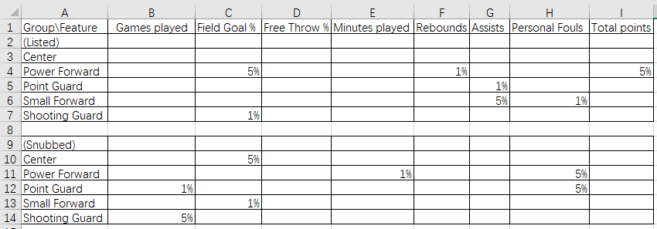
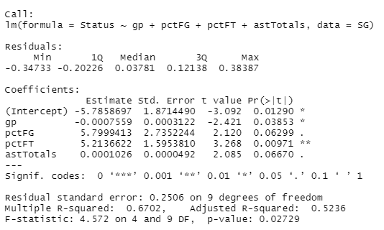
Multiple Linear Regression
Plus, we also applied the idea of backward selection on the conditional distributions for each position, and the significant relationships are displayed on this figure.
Basically, snubbed players have better personal stats like field goal rate and personal fouls, while listed players have better teamwork stats like rebound and assists.

Slide 10
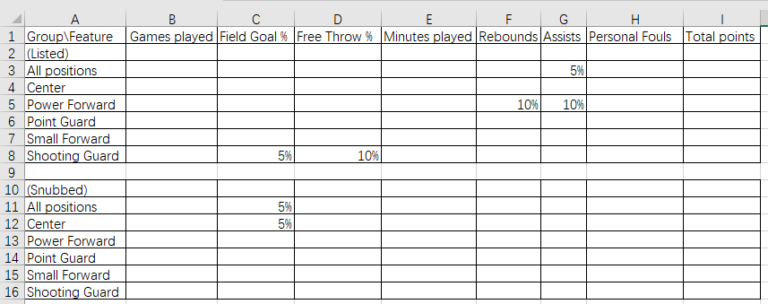
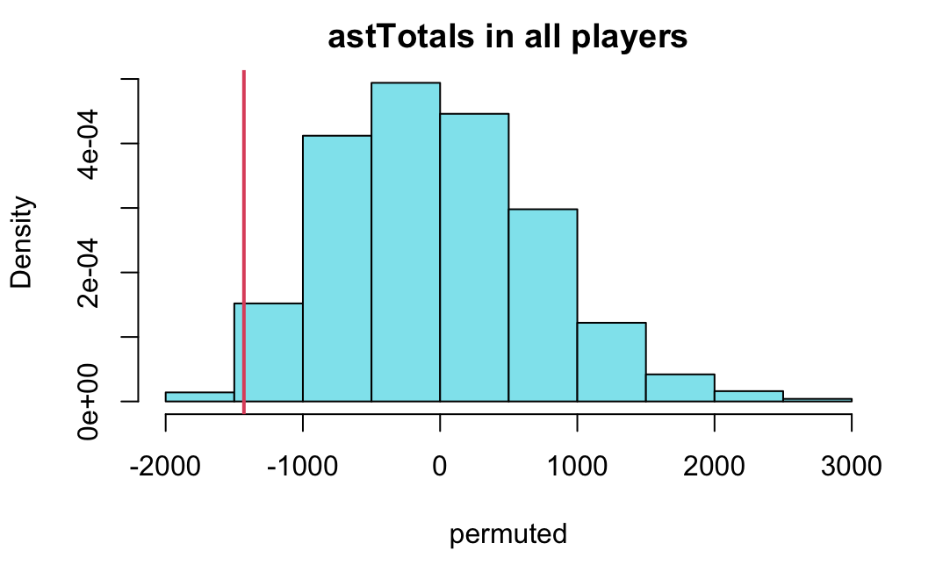
Permutation Test
Null hypothesis: the Status of players are evenly distributed along features.
Alternative: Either listed or snubbed players are better along the feature.
For either all positions or position-wise permutation test, we found that listed players are most adept on teamwork stats, while snubbed players focus mainly on the field goal rate.

Slide 11
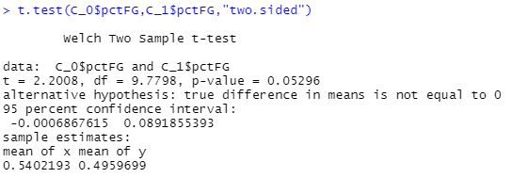
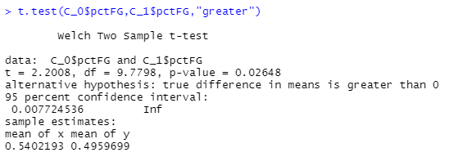
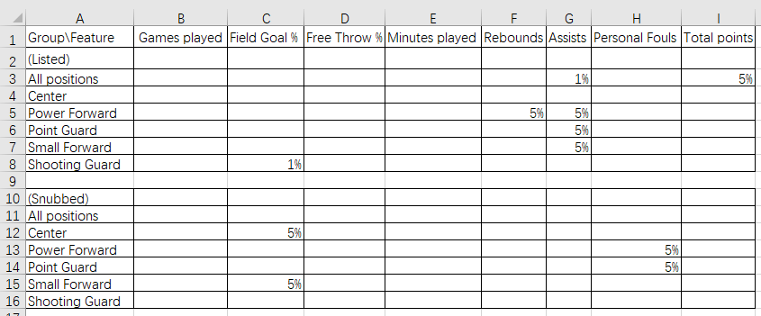
3. T-test
We also applied the two sample T-test to our dataset:
Two sample T-test compares the mean of 2 groups, with null hypothesis in shape of Student t-distribution.
For every position/feature pair, we performed 2-sided test at first to determine the existence of a difference in mean; then, for these “significant” arguments we applied 1-sided test to determine the significance level.
What’s the result?
While listed players generally have significantly more assists, the significant advantages of snubbed players focus on field goal rate and (less) personal fouls.
Significant?
Figure 1: example procedure for an argument
Problem: How do we interpret the results from the 3 statistical methods? Is there any general pattern we could conclude from them?
Figure 2: Significance table (Position vs. Factor)

Slide 12




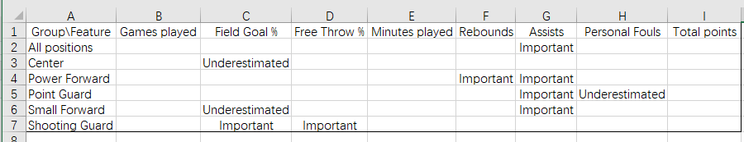
4. Generalization
In order to generalize the results, we let methods vote:
A factor is important (for list) if at least 2 of the 3 methods suggest listed players are better for that.
...or underestimated if most of methods suggest snubbed players are better for such factor.
Then what is the general result?
While listed players generally have more assists than snubbed players on same position, the advantages of snubbed players mainly focus on field goal rate and (making less) personal fouls.
The 3 methods agree on most of the arguments, and T-test has the most similar results to the generalization.
MLR
Permutation
T-Test
Figure 1: Method to integrate the results
Next, it is time to interpret these results and make our conclusion about the preference of the 75th anniversary list and its suggestions...
Figure 2: Generalized Suggestion table (Position vs. Factor)

Slide 13
Conclusion

Slide 14
Conclusion
The list focuses on players with better power of shooting than assists because of the fact that these players could bring greater direct impression on the audience by their scoring performance, while the list might consider more on the overall contribution to the team.
Analyzing different positions distinctively, the suggestion made sense for C and SF, the 2 positions involving most of the scoring; however, it is vague for PG and not apt for PF and SG positions.
While the average usefulness is fair, the snubbed players seems to mainly focus on the ability to score baskets and underestimate the importance of other important attributes, which proves a possible reason that these players were actually snubbed from the list.

